Slide 1
Social media modeling of human behavior in natural emergencies
Sorin Matei, Rajesh Kalyanam, Lan Zhao, Carol Song
PEARC ‘18
July 24, 2018

Slide 2
outline
Introduction
Social behavioral theory
Social media analysis goals
System design
Risk behavior analysis (in progress)
Future work

Slide 3
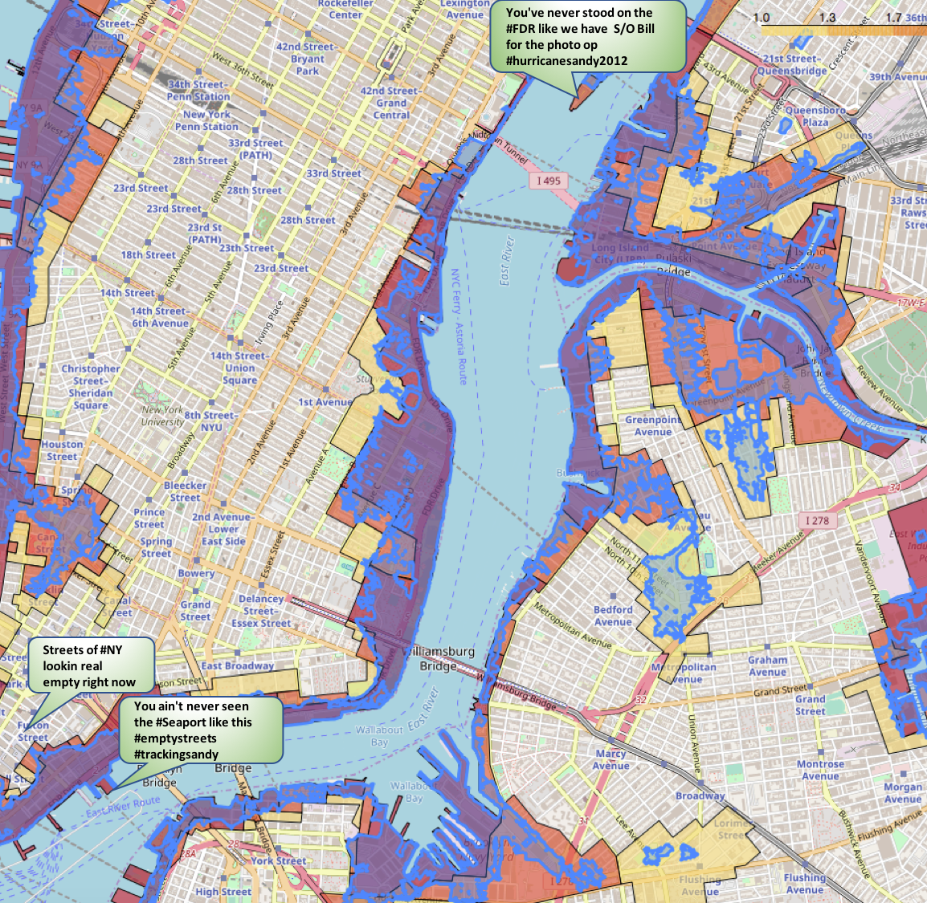
introduction
People are often active on social media during natural emergencies
~195K tweets during Hurricane Sandy
Some may even engage in risky travel behavior
How do we quantify risky travel behavior?
Does the user’s social media content indicate their propensity for risky travel?
How do the user’s peers affect the user’s travel decisions?
Can we put out safety messages via well-connected individuals?
Map of evacuation zones, actual flooding during Hurricane Sandy and a user tweeting from three different places

Slide 4
Social behavioral theory
Appraisal Theory
Choices driven by purposes rather than unconscious factors i.e. no automatic triggers
Human response to stressors either emotional or problem focused
In crises, humans use the most immediate forms of communication available
Reactions impact (risk) behavior: to travel or not to travel?

Slide 5
Social media analysis goals
Determine factors impacting behavior in crises
Emotional vs purpose-driven (“actional”) responses
Sentiment, semantic analytics
Effect of peers’ responses
Quantify risk behavior using travel path
Movement towards or away from areas of (varying) risk
Account for travel speed, distance traveled
Simplify data collection, analysis for any weather event

Slide 6
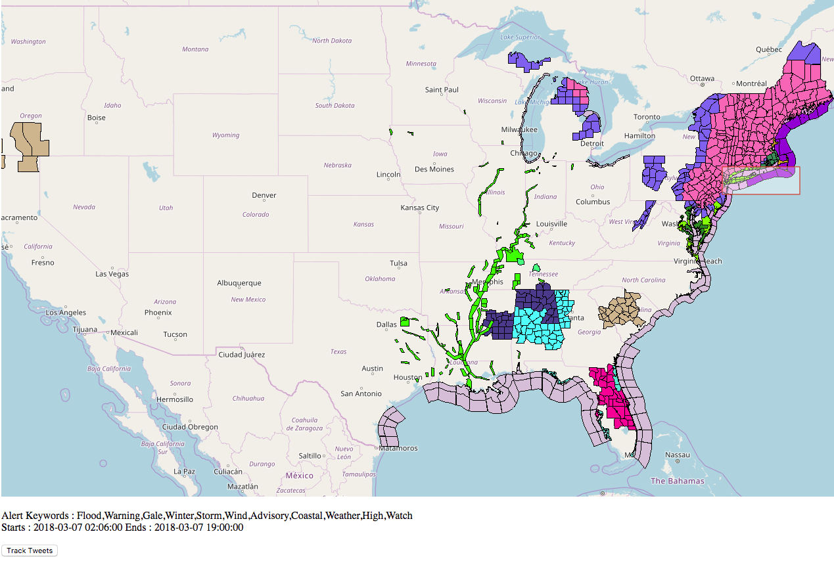





System overview
Risk behavior prediction, simple analytics
Current weather events
Filter
for relevance to event, location
Semantic, sentiment analytics
Public tweets
Storage for efficient retrieval

Slide 7
system design – weather events
NWS (National Weather Service) publishes active weather alerts and event data in various formats
NWS Geospatial data follows OGC (Open Geospatial Consortium) standards
WMS (Web Map Services) provides images of current alert regions
WFS (Web Feature Services) provides information about each event polygon: duration, type of alert, etc.
OpenLayers Javascript library can process WMS, WFS data to display map on HTML webpage; supports drawing bounding box
Ajax used for asynchronous query of alert data for user-selected region of interest
Filter for relevance
Sentiment, semantic analytics
Storage for later retrieval
Risk prediction, analytics

Slide 8
system design – Twitter data
Access Twitter public streaming API; utilizes OAuth authorization protocol
Created service account, registered application
Authorization obtained using application-specific tokens, keys
Query using keywords determined from user-selected weather events
Produces stream of recent, public tweets
Filter for relevance
Sentiment, semantic analytics
Storage for later retrieval
Risk prediction, analytics

Slide 9
system design – stream processing
Process streaming tweets to retain just relevant ones
Use GeoLocator software to identify locations from text - fewer than 2% of tweets report location
Determine each tweet’s sentiment - gauge emotional responses
Use Stanford’s CoreNLP software
Determine tweet’s relevance to weather event – gauge “actional” information
Use Mallet topic classifier trained using text of official weather alerts - Twitter search does a poor job of filtering to supplied keywords
Filter for relevance
Sentiment, semantic analytics
Storage for later retrieval
Risk prediction, analytics

Slide 10
system design – storage
Requirements
Support efficient retrieval
Support both schema-based and schema-less data query
Scalability, separation of individual data collection results
Enable automatic, rich analytics
Ingest data for each collection process into a separate Elasticsearch index
Coerce data into data types enabling simple analytics; e.g. geo_point, floating point numbers
Filter for relevance
Sentiment, semantic analytics
Storage for later retrieval
Risk prediction, analytics

Slide 11
System design – putting it all together
Twitter spout
Process public streaming tweets
Tweet geolocator bolt
Geolocate tweet and filter to region of interest
Sentiment analysis bolt
Augment tweet tuple with 5 sentiment scores
Relevance analysis bolt
Topic classification to determine relevance score
Elasticsearch ingestion bolt
Store in ES index
Real-time distributed stream processing framework
Utilize Apache Storm
Configurable processing flow represented as directed acyclic graph (DAG) of “spouts”, “bolts”
Streaming data sources (spouts), pluggable processor blocks (bolts) exchanging, transforming tuples
Scalable to several nodes operating in parallel

Slide 12
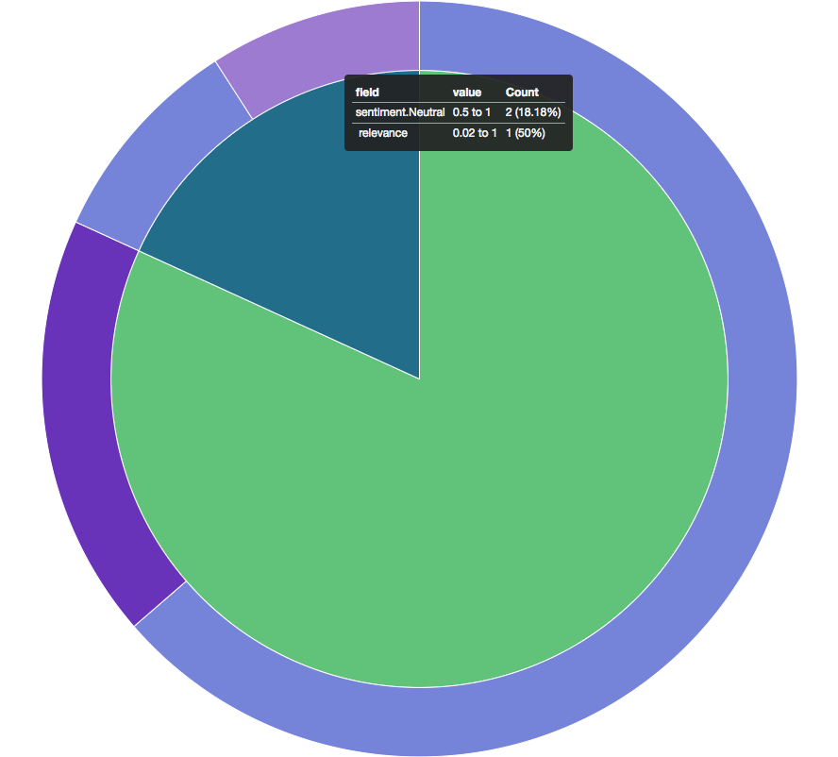
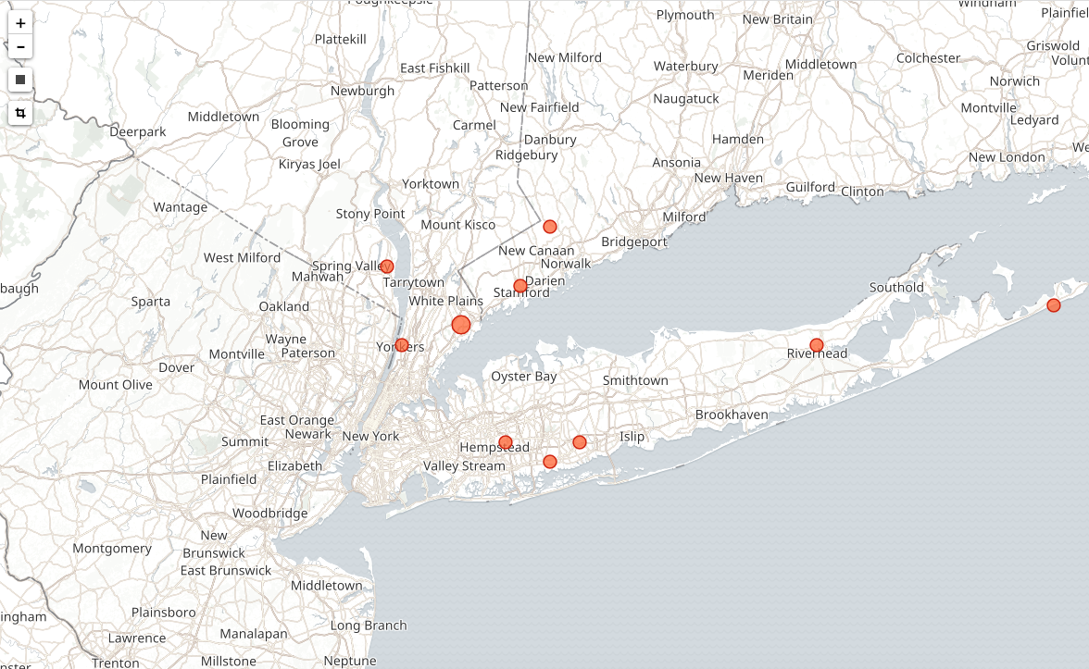
system design –analytics
Kibana enables exploration of data from Elasticsearch index
Supports slicing, range queries of numeric fields
Heatmap generation from geo_point fields
Filter for relevance
Sentiment, semantic analytics
Storage for later retrieval
Risk prediction, analytics

Slide 13
RISK behavior analysis
Work in progress
Quantify user risk using average movement vectors, risk “level” of various locations
Tweets with “actional” information
Parts-of-speech tagging to identify verbs
Topic modeling, classification using ”official” tweets corpus of “informational” tweets
Tweets with high “relevance” score
Emotional tweet content
Sentiment scores
Parts-of-speech tagging to identify adjectives
Predict risk using emotional vs actional tweet proportions, self vs peer effects
Other modeling possibilities…

Slide 14
Future work
Test risk behavior prediction model
Integrate risk estimation, topic classification, tagging into Storm pipeline
End-to-end workflow, interface for public use
Scaling, load balancing for production use

Slide 15
Thank you
https://bit.ly/2ycNVlA
rkalyana@purdue.edu

